Slide 1









Mobile Phone & Online Safety

Slide 2
Outcomes:
*for parents/guardians to feel more informed about ways in which technology can be promoted safely in the home.

Slide 3




Lets get some facts...
  Vast majority of children in the UK own a smart phone by the age of 11, with ownership rising from 44% at age 9 to 91% age 11years.
  Youtube was one of the most popular apps used across the school and actually has an age rating of 13+
  We have some children age 5/6 a 13+ game.
  A large number of children have access to a device which allows them on the internet in their bedroom. (80% in one Y6 class!)
  Real local dangers include grooming, malicious communications and online bullying.
  Mobile phones often cause issues in school

Slide 4





“It wasn’t like that when I was young”
Notes:
Times are changing and will continue to change quickly.
I was 16/17 when I got my first phone.
I was 18 when I got an email address.
I couldn’t go on the internet if someone in the house was on the phone etc
It was just what everyone did then.
People may say that technology is damaging children and society and to some respects, it can do.
We can not keep our children away from technology (what if they go to a friends house etc), all we can do is educate children on how to use them safely and restrict or limit their access using parent setting etc.

Slide 5




What are your concerns about your child being online?

Slide 6
Benefits of children using technology

Slide 7
How can technology benefit children?
Hand eye coordination
Wealth of information
Language skills
Problem solving skills
Notes:
Educational games that require children to follow objects and interact with them can help their hand eye coordination, also their understanding of how to interact with systems, for example knowing that pressing the right button will invoke the desired action. HOWEVER there are growing issue of young adults not having finger dexterity to cope with certain jobs e.g. dentistry????
Children can only learn what is available to them, traditionally parents, friends, school, and the wider community would have been the only gateways to learning. Now the World Wide Web gives them a vast library of material to allow them to discover new things.
Knowing they can ask the computer anything they want to know drives a child’s desire to do research, many children will use voice to enter their search queries into search engines, and then need to read and evaluate the results that are presented. Over time their language will improve and they will become faster and more adept at finding the information they want.
Interactive websites and games help children learn to solve problems as they work their way through the challenges presented to get to the next level. Even simply using the devices makes them more adept at this, learning how to solve problems like programs not working correctly or connection issues.

Slide 8
What are children aged 8-11 years doing online?
National Online Safety

Slide 9
Creating a safe culture
At school
*Online safety lessons
*restrict time *limit access
*filtering & monitoring software
At home
?
Notes:
What can you do at home…

Slide 10
Set clear ground rules
Use technology to protect them
Creating a safe culture at home…
Spend time with them online
Let them have fun and express themselves
Get in the know...Knowledge is key!
Notes:
Have honest conversations with your children about who they communicate with and how, and who can see what they post online.
Explain that anything that goes online – pictures, videos, comments, things they share with others and what others post and share with them and about them – leaves behind a trail of information about them. To make sure they’re leaving a positive “digital footprint”, they should be mindful about what they do and say online.
Make sure they understand that discriminatory or inappropriate contact is never acceptable. No one should spread rumours or share hurtful or embarrassing stories or photos. What may seem like a harmless joke to one person can be deeply hurtful to others.
If your child experiences something online that makes them feel upset, uncomfortable or scared, encourage them to tell you or a trusted adult immediately.
Children often ‘know’ the perpetrators of online harassment or abuse, so it is important to help them to be alert and know how to respond to any problematic behaviours they encounter online.
Work with your child to establish rules on how, when and where to use devices.
Check that your child’s device is always updated and running the latest software, and that privacy settings are on and configured to minimize data collection so that people don’t see any information that you don’t want them to see.
Help your child learn to keep personal information private. If your privacy settings are not secure, anyone can see your information.
Keep webcams covered when not in use. For younger children, tools such as parental controls like safe search, can help keep online experiences positive.
Be cautious of free online resources, including educational ones. If your child is asked to provide a photo or their full name, be sure it is a trusted website.
Create opportunities for your child to have safe and positive online interactions with friends, family and you. Connecting with others can be an excellent opportunity for you to model kindness and empathy in virtual interactions.
Help your child recognize and avoid misinformation and disinformation, age-inappropriate content and content that can potentially cause anxiety or other harm. Introduce them to trustworthy sources of information.
Children can be exposed to advertising that may promote unhealthy foods, gender stereotypes or age-inappropriate material. Help them to recognize online ads and use the opportunity to explore together what is wrong with some of the negative messaging you see.
Spend time with your child to identify age-appropriate apps, games and other online entertainment. Be alert for apps that may have harmful content or pose privacy risks.
Promote positive online behaviour by practicing it yourself. Be mindful of the example you set and what you share online about your child, including their photos and videos.
Encourage your child to be kind online and to support friends and family by sending positive messages or emojis.
If they have classes online, encourage them to be respectful of others and to be mindful of what can be seen on camera to maintain privacy.
Be alert if your child appears to be upset or secretive with online activities. Reassure them that experiencing abuse or harassment is never their fault and they shouldn’t keep it a secret.
Familiarize yourself with their school’s digital learning policies. Seek out local helplines and resources for the latest issues in keeping children safe online and how to report cyberbullying or inappropriate content.
Spending time online can be a great opportunity for your children to be creative, learn, use their voices to share their views and support causes that are important to them.
Encourage your child to use resources on the internet to help them get up and get moving, like online exercise videos for children and video games that require physical movement.
Remember to balance online activities with an active lifestyle and offline recreation for a healthy balance in all aspects of life.

Slide 11
Parental controls allow you to block and filter upsetting or inappropriate content. They work across wifi, phone networks, individual apps and devices.
Setting up parental controls
Notes:
Parental controls can help you to:
plan what time of day your child can go online and how long for
create content filters to block apps that may have inappropriate content
manage the content different family members can see.
EE has useful parent guides and so must other networks.
EE Smart Hub With WiFi Controls | Smart Broadband Routers | EE

Slide 12
Mobile phones -
Let's hear what the children think...

Slide 13
Why do you need a mobile phone?
"To communicate with people because if I get lost I can ring someone."
"Just for safety like when I am coming home from school or anywhere else alone something could happen to me or I could get lost."
"When I'm bored I can play games on it."

Slide 14
Why do you need a mobile phone?
"I feel the need to have a phone because what if a fire or a flood happens when I'm alone. I also need a phone to send text messages about important things."
"To do homework or for keeping in touch with friends or family so I can speak to them if I don't see them very often."
"So I can feel grown up."

Slide 15
Why do you need a mobile phone?
"I want a phone because then I could go out by myself and call anyone when I want to. Also because it's portable , light and convenient for travelling when you have google maps."
"I want a phone because I want to be able to be part of group chats."

Slide 16
Parents, why does your child need a mobile phone?

Slide 17

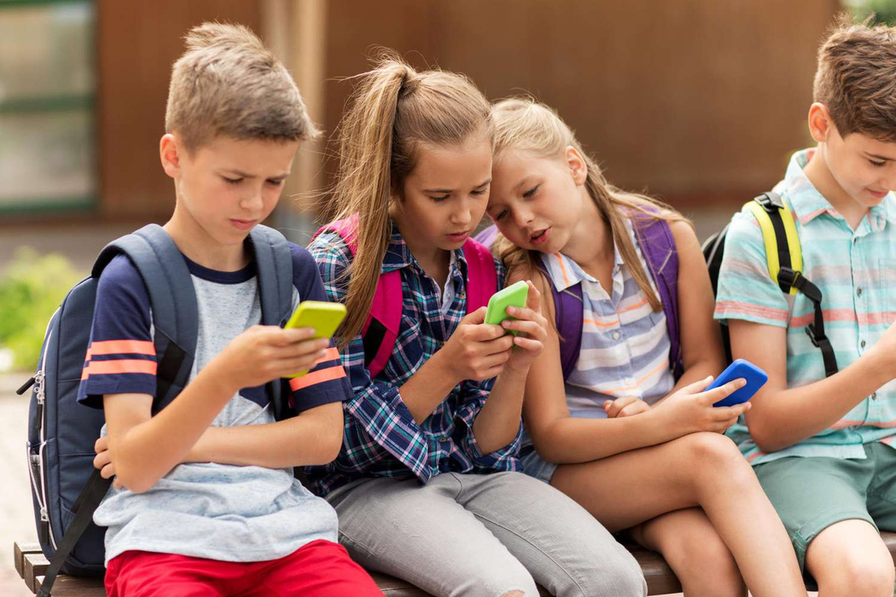

Making the leap
However apprehensive we may feel, there will come a time (if it hasn't already) when each of us will allow our child to have a mobile phone. So we must do what we can now to get them ready

Slide 18
Get children ready.
Set guidelines / rules and stick to them.
Get in the know...Knowledge is key!
Notes:
Ensure children have clear and realistic expectations of what it will be like to own a mobile phone ie. style/cost of phone, purpose/use of phone, boundaries/rules
Ensure guidelines are in place - limit time on phone, cut off time, apps available, sanctions for improper use.
Find out what could go wrong, problems of phones, how you can minimise them, how you can stay as up to date as possible with advances in technology.

Slide 19


Main Potential dangers
1
3
5
Target for theft
2
Online grooming
Oblivious to surroundings
4
6
Health problems
Malicious communications crime
Online bullying
Impact on digital footprint

Slide 20
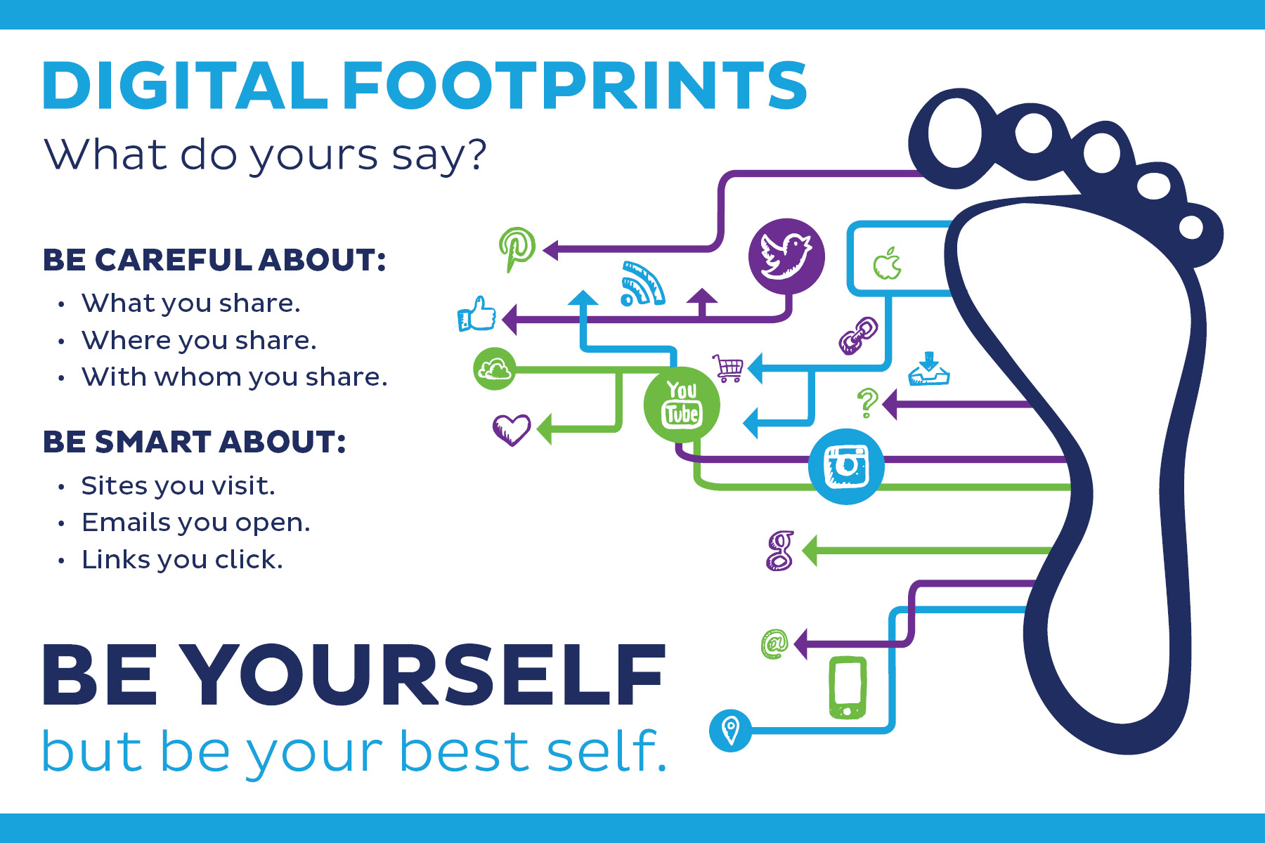

Slide 21
What can you implement at home?
  Prepare your child and manage expectations.

Slide 22
  Who will own the phone?
  Will your child have a limit on their screen time?
  Will there be certain hours that your child will not access their device?
  When downloading apps, will your child require parental permission?
  Will your child be allowed on social media? If so, which platforms?
  Could there ever be a time when your child has their phone taken off them? What would the circumstances be?

Slide 23
What can you implement at home?
  Parental Controls

Slide 24
  Set up controls on the device (children can be quick to learn how to bypass this)
  Download a parental control app such as Google's 'Family Link', or Apple's 'Our Pact', and set up parental controls through that.
  Ensure all apps that are downloaded, have parental controls enabled.
  Run your child's device through a separate wifi connection which has stricter restrictions, therefore limiting what they can see and do. This will only be effective when using their phone at home on Wifi.

Slide 25
https://www.internetmatters.org

Slide 26
What can you implement at home?
  Location tracking

Slide 27
Tracking their phone means you can see where they are at all times (or where the phone is!)
Set tracking alerts eg. when they leave the house, when they arrive at school.
Tracking enabled means that children can also post their location using apps and can be tracked by third parties. This can be avoided by disabling tracking in certain apps.

Slide 28
What can you implement at home?
  Whatsapp

Slide 29
How can you stay safe on Whatsapp?
  privacy settings - make sure they have to be invited into a group and can't just be added.
  Make sure your child is only connected to trusted people.
  Disabling the last seen message & read reciepts can be useful if your child feels pressured to reply to messages, or to be online and responding at a particular time.
  Make use of the 'Report' and 'Block' features if you feel it is required. Teach your child to use them too.
  Check your child's messages and group chats

Slide 30
What can you implement at home?
  Check your child's phone regularly

Slide 31


THANK YOU

